Slide 1
NEW TOPIC
Linear Equations
Topic: Algebra Recap
EQ: What have we learnt about algebra so far?
Mrs Stretch
Year 7

Slide 2
Contents
Glossary or Formula Page
Page
Date
Description
Word
Description
2
3

Slide 3
Tasks
24
7
30
Topic
Essential Question
Questions
Notes
Summary
8
9

Slide 4
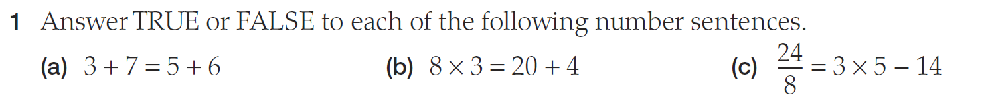
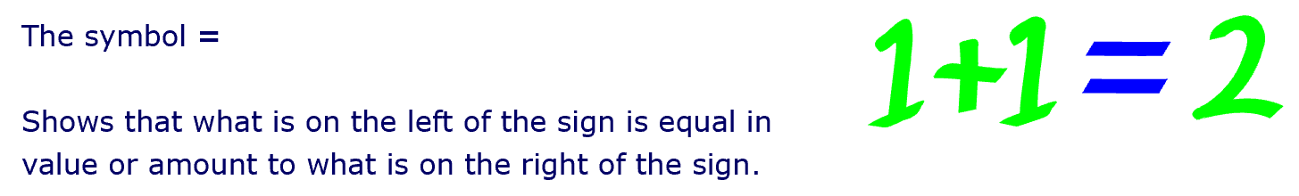
24
7
30
Algebra Recap
Date
EQ – What can we remember last time we did Algebra?
The Equal Sign

Slide 5
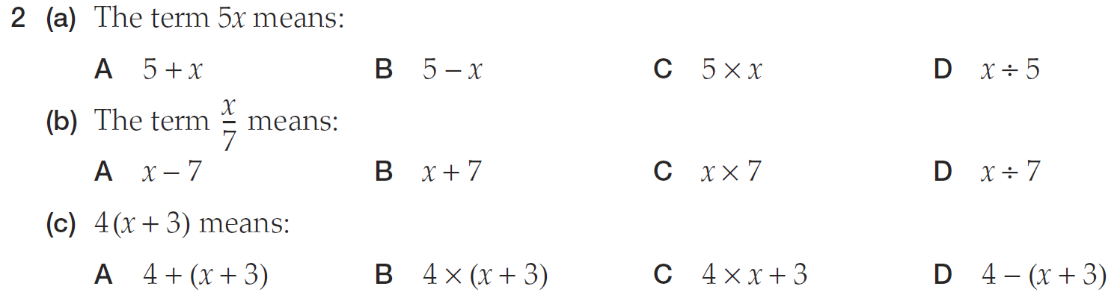
24
7
30
Algebra Recap
Date
EQ – What can we remember last time we did Algebra?

Slide 6
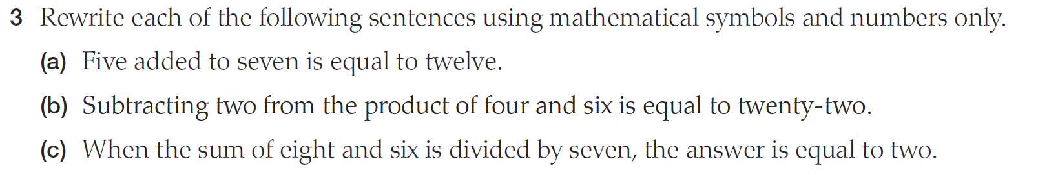
24
7
30
Algebra Recap
Date
EQ – What can we remember last time we did Algebra?

Slide 7
Addition +
Add
Sum
Plus
Both
Combined
Increase
Total
Join
Subtraction -
Decrease
Difference
Left over
Minus
Reduce
Remains
Remove
Take Away
Multiplication x
By
As much
Equal Groups
Multiply
Lots of
Product of
Times
Division ÷
Average
Divide
Each
Equal Parts
Evenly
Out of
Quotient

Slide 8
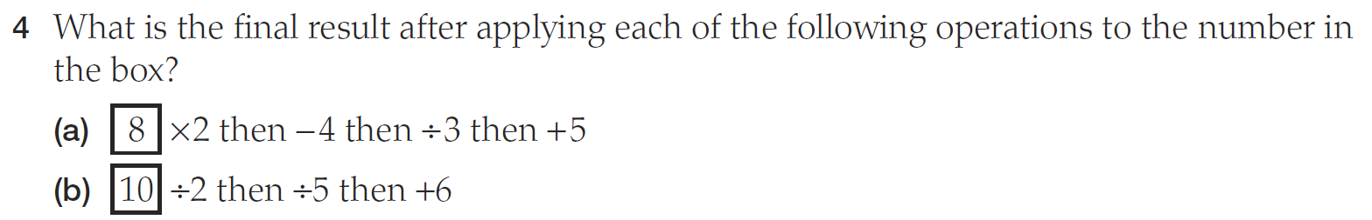
24
7
30
Algebra Recap
Date
EQ – What can we remember last time we did Algebra?

Slide 9
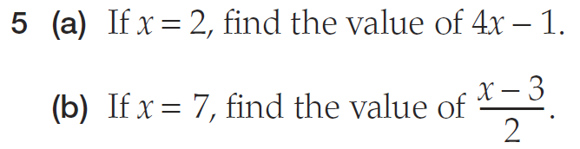
24
7
30
Algebra Recap
Date
EQ – What can we remember last time we did Algebra?
Substitution
When you sub in a number where the letter was

Slide 10


Slide 11

Word Wall
The class is going to create an Algebra Word Wall. We are going to use all the important words associated with Algebra and make posters for future reference.
The best posters will be laminated and stuck on the wall.
You will be given an information sheet to help you make the poster.
Notes:
Teachers, print some info sheets to give to your kids to use.

Slide 12
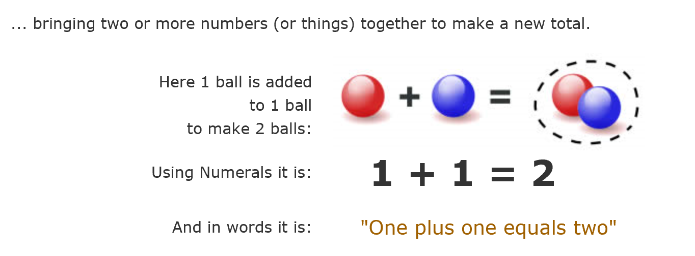
Info Sheet 1
Addition +
Add
Sum
Plus
Both
Combined
Increase
Total
Join

Slide 13
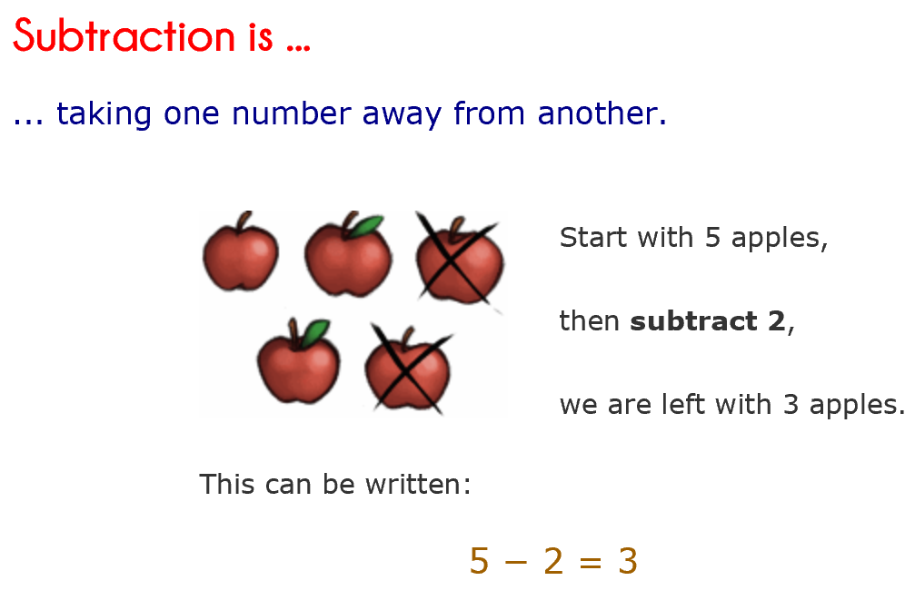
Info Sheet 2
Subtraction -
Decrease
Difference
Left over
Minus
Reduce
Remains
Remove
Take Away

Slide 14
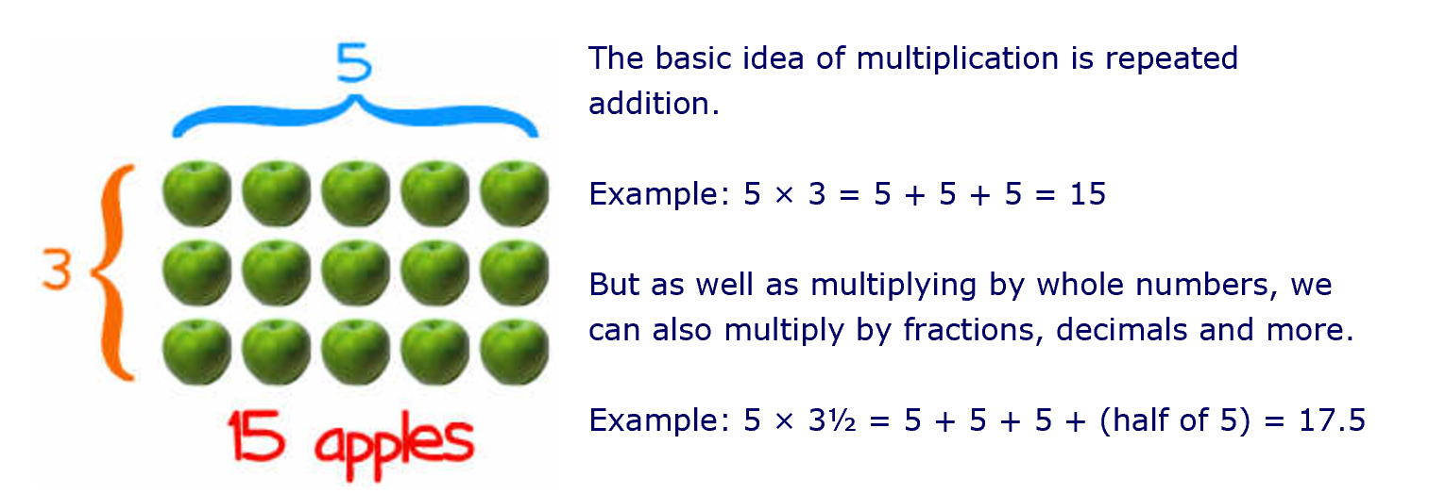
Info Sheet 3
Multiplication x
By
As much
Equal Groups
Multiply
Lots of
Product of
Times

Slide 15
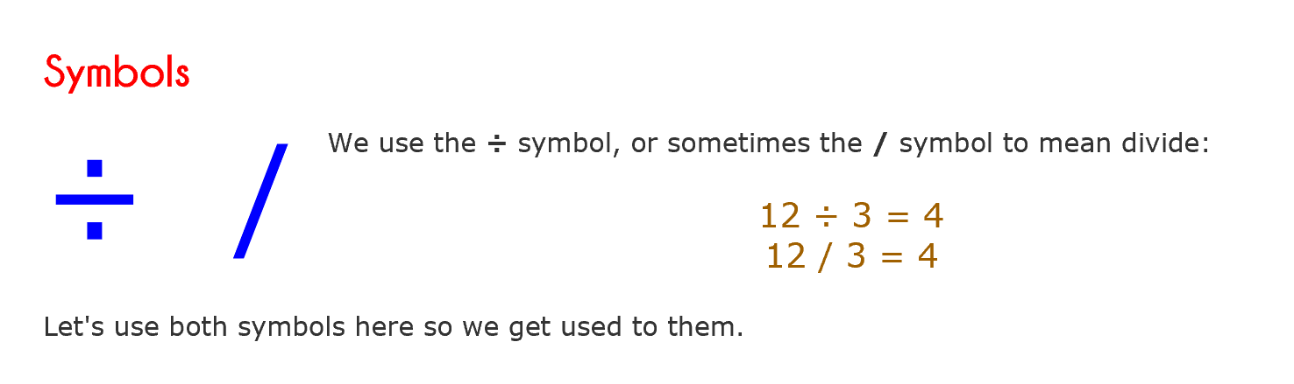
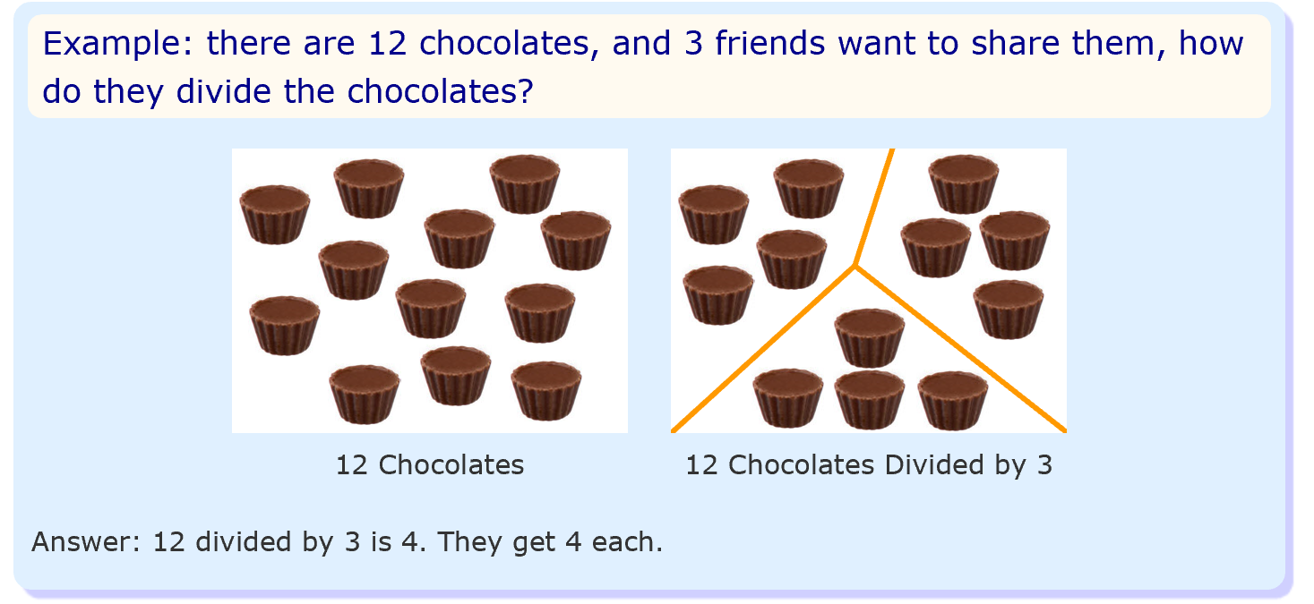
Info Sheet 4
Division ÷
Average
Divide
Each
Equal Parts
Evenly
Out of
Quotient

Slide 16
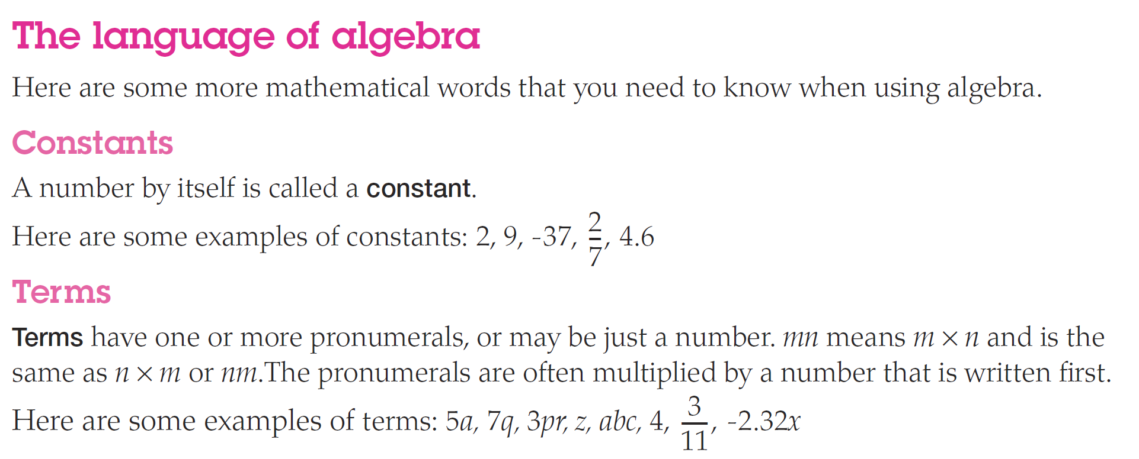
Info Sheet 5

Slide 17
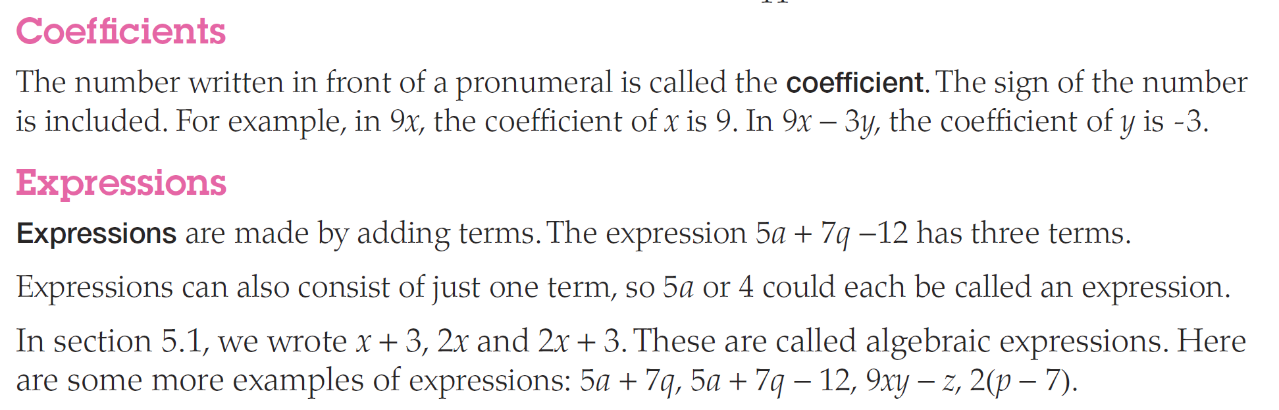
Info Sheet 6

Slide 18
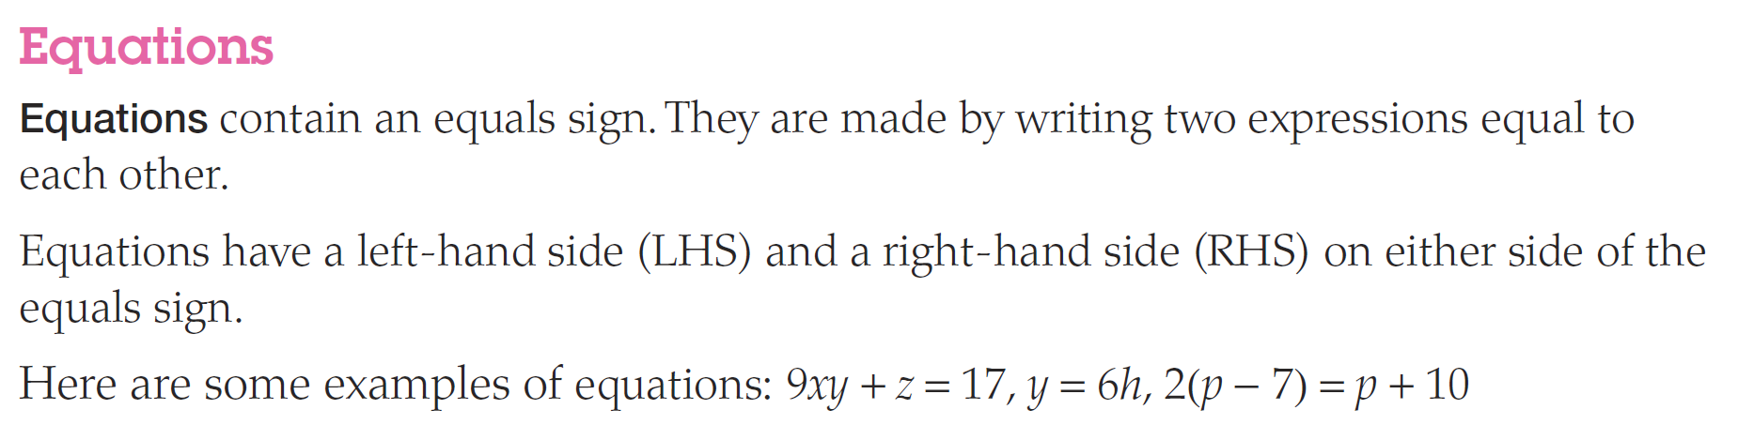
Info Sheet 7

Slide 19
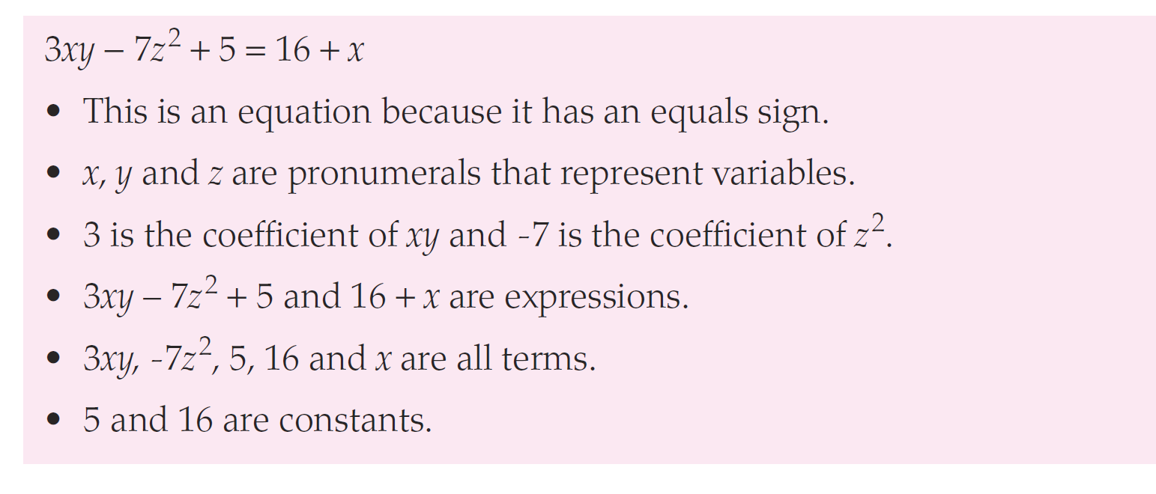
Info Sheet 8

Slide 20
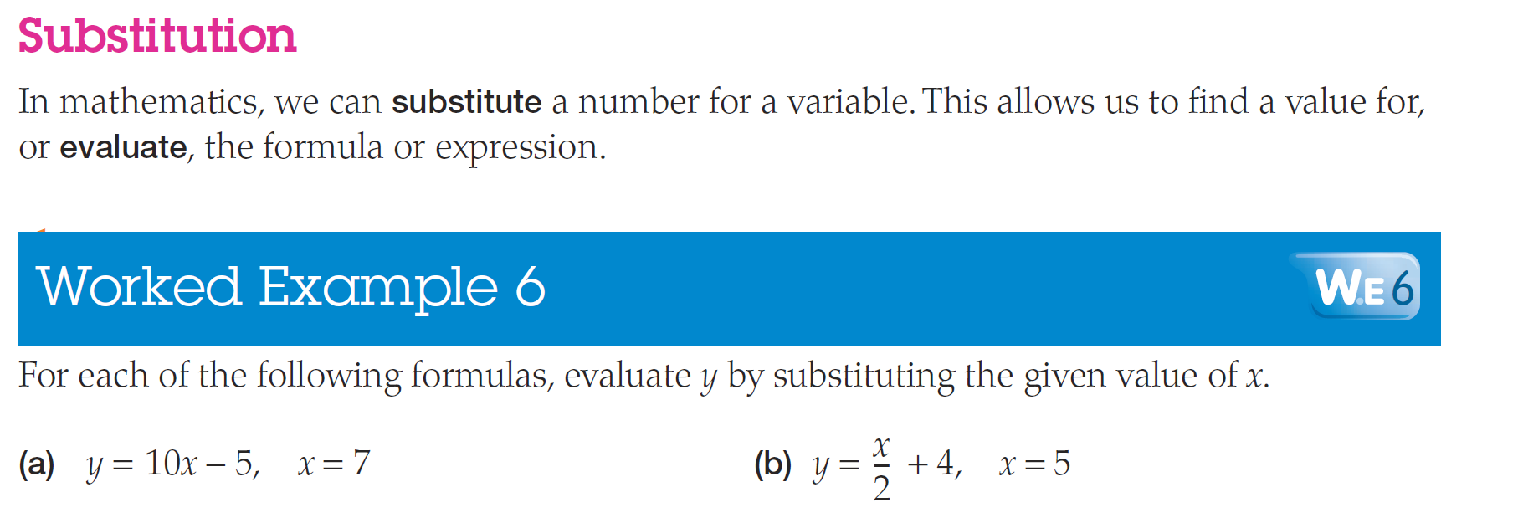
Info Sheet 9

Slide 21
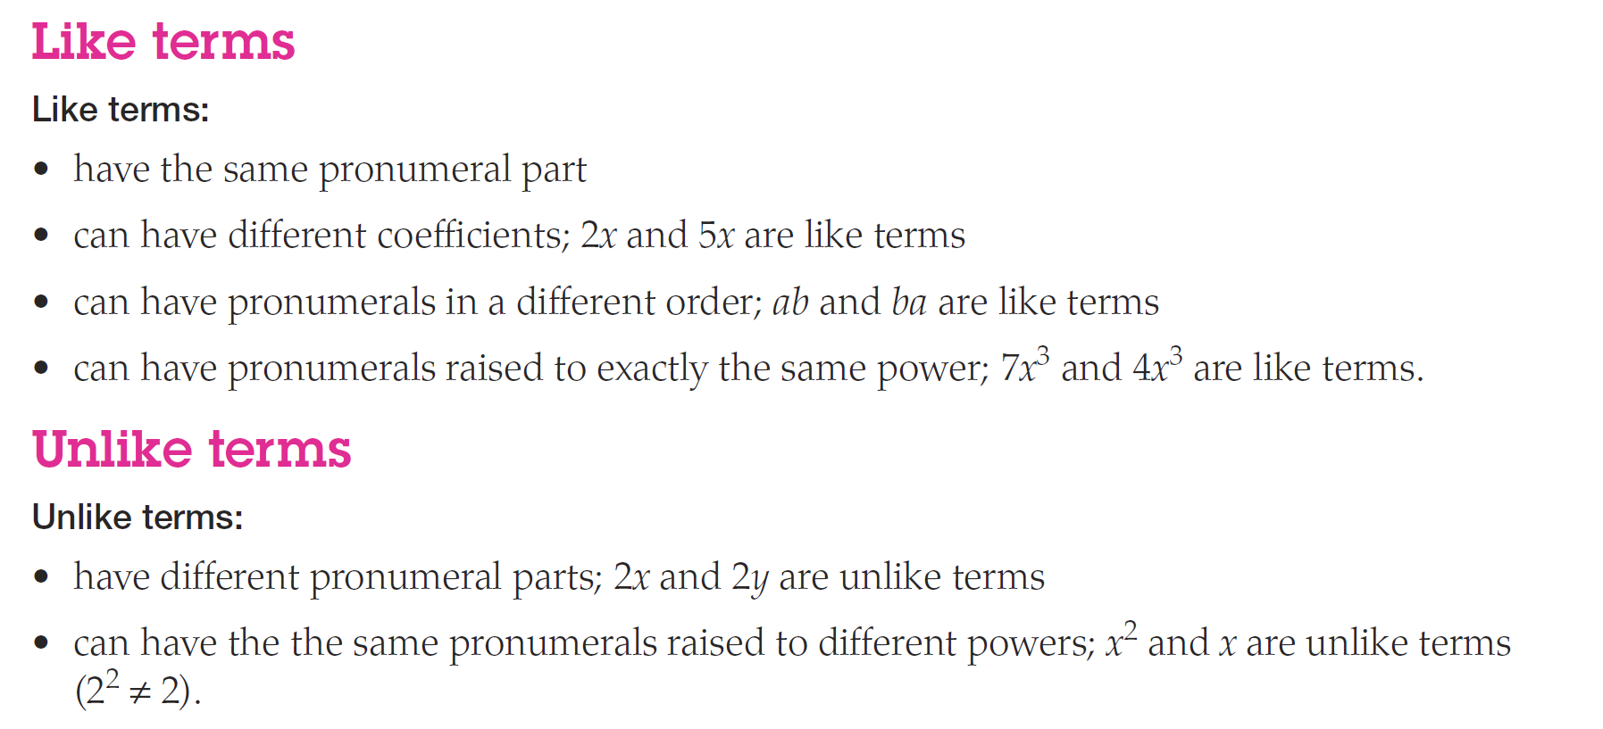
Info Sheet 10

